Slide 1

01
Introduction to NN, CNN and GNN (24AIM113) & Analog System Design (24AIM114)
StraightUp : A Smart Posture Correction System
TEAM MEMBERS :
CB.AI.U4AIM24007- ARNITA N CB.AI.U4AIM24021- THANMAI SAI K CB.AI.U4AIM24035- SAI PRANAVI R CB.AI.U4AIM24040- SHREENIDHI G
FACULTY :
DR. SNIGDHATANU ACHARYA
DR. AMRUTHA V

Slide 2
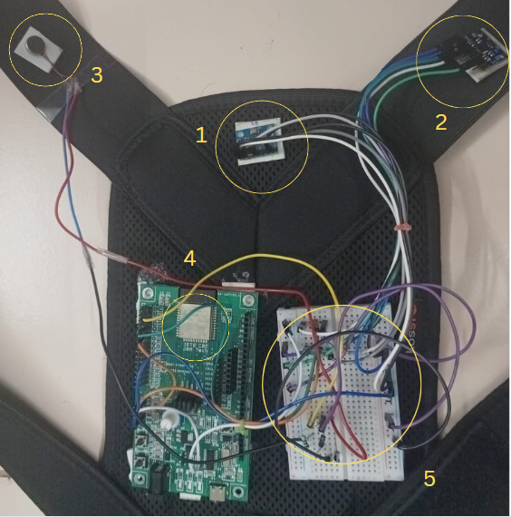
02
PROJECT OVERVIEW
StraightUp is a wearable device that helps people sit with better posture.
It uses two motion sensors called MPU6050. One of them is placed in the upper thoracic region, and the other on top of the right shoulder.
A microcontroller called ESP32 processes this sensor data.
It uses a simple neural network (FNN) to understand if your posture is good or bad.
If you are sitting in bad posture for more than a minute, the device gives a gentle vibration alert so you can correct it.

Slide 3
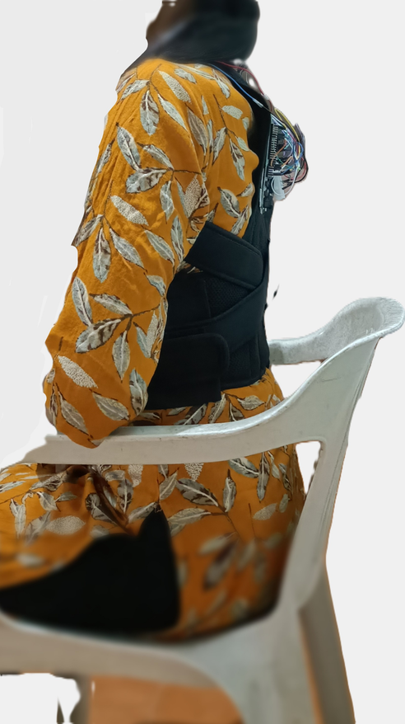


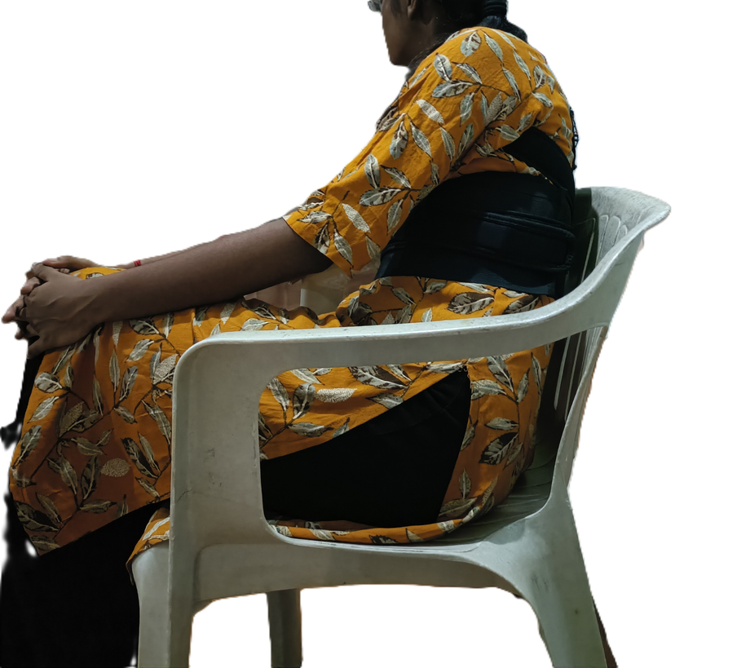

03
POSTURES
(1)
(2)
(3)
(4)
(5)
(1)
Good posture-Straight Up
(4)
Bad Posture 3- Right side Slouching
Bad Posture 1 - Forward Slouching
(2)
(5)
Bad Posture 4- Slouching on left side
(3)
Bad Posture 2- Backward Slouching

Slide 4
04
LITERATURE REVIEW
Paper Title | Relevance to Our Project | ML Algorithm
ED-FNN: A New Deep Learning Algorithm to Detect Percentage of the Gait Cycle for Powered Prostheses | Validates use of FNN on IMU data for posture/movement detection | Feedforward Neural Network (FNN)
A Wearable Intervention for Posture Correction by Pfab | Same IMU placement on thoracic region for posture tracking | Basic Pattern Recognition
SPLIGN Smart Belt | Same sensor setup, but uses cloud; ours works offline | Random Forest

Slide 5
05
COMPONENTS AND CONNECTIONS
Component | Connection
Vibration Motor | One terminal → 12V power supply
 | Other terminal → Collector of NPN transistor
NPN Transistor | Base → ESP32 GPIO16 (via 1kΩ resistor)
 | Collector → Vibration Motor -ve terminal
 | Emitter → GND (common with ESP32 and power supply)
Diode | Cathode (strip end) → 12V (motor +ve terminal)
 | Anode → Collector (motor –ve terminal)
MPU6050 Pin | Connection (ESP32)
VCC | 3.3V
GND | GND
SCL | GPIO22
SDA | GPIO21
AD0 | GND (1- 0x68) 3.3V (2- 0x69)

Slide 6
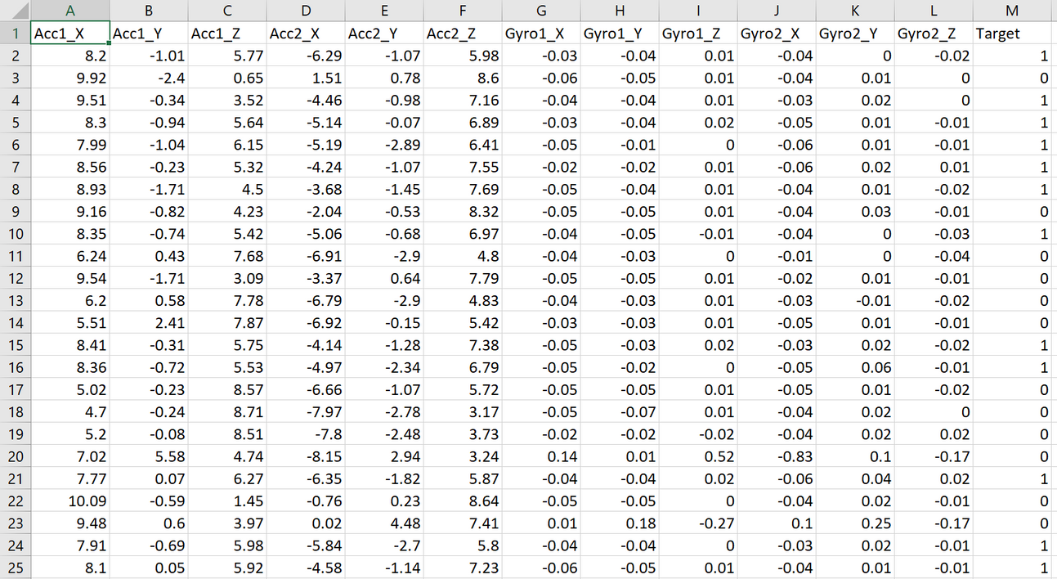
06
DATA COLLECTION:
Data Collection Frequency:
Sampling Rate: 2.5 Hz (1 sample every 400 ms).
Controlled by: delay(400) in Arduino code.
14,782 data points from 20 people.
Data Collected from Two MPU6050 Sensors:
Accelerometer (X, Y, Z)
Units: m/s²
Detects tilt, bending, and orientation of the back and shoulder.
Gyroscope (X, Y, Z)
Units: °/s
Tracks rotational movement and quick shifts in posture.

Slide 7
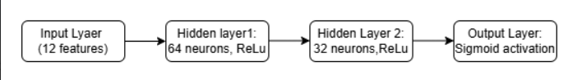
07
WHY NEURAL NETWORKS:
Traditional rule/threshold-based systems often fail
Machine learning approach chosen due to inconsistent sensor data
Neural networks capture non-linear relationships effectively
Feedforward Neural Network (FNN) selected - Simple architecture ,Low computational requirements
Lightweight and ideal for ESP-32 deployment
FNN ARHITECTURE:
FNN Architecture

Slide 8
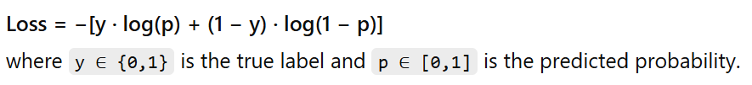
07
LOSS FUNCTION:
Binary Cross-Entropy used for binary classification.
Measures the dissimilarity between predicted probabilities and actual binary class labels.
OPTIMIZATION:
Used Adam Optimizer (Adaptive Moment Estimation).
Extension of Stochastic Gradient Descent with adaptive learning rates per parameter.
Combines benefits of Momentum and RMSProp by maintaining moving averages of gradients and their squared values.
Epochs: 10
Batch size: 32
Learning rate:0.01

Slide 9
07
Model Deployment on ESP32
ESP32 Characteristics:
ESP32 is a small microcontroller that can run uploaded programs.
Cannot train machine learning models due to limited computational power.
Model must be trained externally using TensorFlow, then converted for ESP32.
Model Conversion Process
1. Convert Keras Model to TensorFlow Lite Format:
Converts the trained Keras model to a .tflite file.
.tflite is a lightweight, platform-independent format ideal for edge devices.
2. Convert TFLite Model to C Array (TinyML Format):
ESP32 cannot directly use .tflite files.
Must convert the .tflite model into a C-style array to embed in firmware.

Slide 10
08
ESP32 DUAL MPU6050 SENSOR INTERFACE WITH VIBRATION MOTOR CONTROL
1. Sensor Initialization:
Accelerometer Range: ±8g
Gyroscope Range: ±500°/s
Filter Bandwidth: 10 Hz
Vibration motor is off by default
2. Data Acquisition:
Outputs 12 motion features via Serial- from Acc1_X to Gyro2_Z
3. Vibration Control Logic- Serial Commands:
"VIBRATE" – Turns motor ON
"STOP" – Turns motor OFF
4. Loop Frequency
Updates data every 400 ms

Slide 11
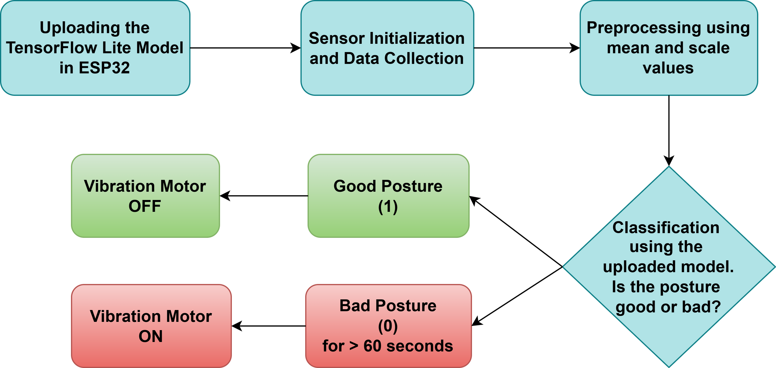
REAL-TIME POSTURE DETECTION USING ESP32 & TENSORFLOW LITE
Results:
Real-time binary posture classification (Correct / Incorrect).Vibration alert for prolonged incorrect posture.

Slide 12
07
RESULTS AND COMPARISON
To ensure the effectiveness of our Smart Posture Correction System, we conducted comprehensive evaluation of multiple machine learning models
Model | Accuracy | F1 Score | Recall | Precision
KNN | 0.9685 | 0.9696 | 0.9795 | 0.9598
Random Forest | 0.9506 | 0.9530 | 0.9788 | 0.9285
SVM | 0.9398 | 0.9400 | 0.9200 | 0.9600
Logistic Regression | 0.8370 | 0.8000 | 0.7400 | 0.9100
FNN | 0.9750 | 0.9800 | 0.9800 | 0.9700

Slide 13
REFERENCES:
1. https://www.mdpi.com/1424-8220/18/7/2389
2.HTTPS://ESSAY.UTWENTE.NL/69090/
3.HTTPS://IJAEMR.COM/UPLOADS/PDF/ARCHIVEPDF/2024/IJAEMR_634.PDF

Slide 14
THANK YOU

